Slide 1

LEGAL UPDATE
BREAKFAST | 10 JUNE 2026

Slide 2
LGPA acknowledges the Traditional Owners of this land, the Whadjuk people of the
Noongar nation and pay our respects to the Elders past and present.
We recognise the unique and incomparable contribution the Whadjuk people have made and continue to make to our culture and in our community.
We would also like to acknowledge all Aboriginal and Torres Strait Islander Elders for they hold the memories, the traditions, the culture and hopes of Aboriginal and Torres Strait Islander Australia.
The land on which we live, meet and thrive as a community always was and always will be Noongar land.

Slide 3
LGPA LEGAL UPDATE
10 JUNE 2026
Craig Slarke
Partner
McLeods

Slide 4
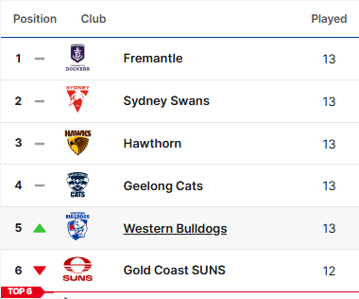

Slide 5
Inconsistency with deemed provisions
Shire of Peppermint Grove v McComish [2025] WASCA 155.

Slide 6
Inconsistency with deemed provisions
Item 6 of clause 61 (1) - single house exempt if:
The R-Codes apply to the works.
The works comply with the deemed-to-comply provisions of the R-Codes.
The works are not located in a heritage-protected place.

Slide 7
Inconsistency with deemed provisions
‘32. ADDITIONAL SITE AND DEVELOPMENT REQUIREMENTS
(1) The Table sets out requirements relating to development that are additional to those set out in the R-Codes, activity centre plans, local development plans or State or local planning policies.

Slide 8
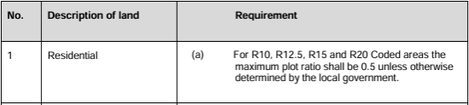
Inconsistency with deemed provisions

Slide 9
Inconsistency with deemed provisions
‘(2) To the extent that a requirement referred to in subclause (1) is inconsistent with a requirement in the R-Codes, an activity centre plan, a local development plan or a State or local planning policy the requirement referred to in subclause (1) prevails.’

Slide 10
Inconsistency with deemed provisions
clause 60(b) of the deemed provisions says that development requires approval unless it is exempted by clause 61;
clause 61 says that a single house that meets the DTC requirements of the R-Codes does not require approval;
the additional plot ratio requirement is inconsistent with cll 60 and 61 of the deemed provisions because it would have the effect that a deemed to comply single house requires development approval;
to the extent there is an inconsistency between a scheme provision and a deemed provision, the deemed provision prevails (PD Act s.273B(3).

Slide 11
Inconsistency with deemed provisions
Clause 61(1) to read that works are exempt works if:
(a) the works are of a class specified in Column 1 of an item in the Table; and
(b) if conditions are set out in Column 2 of the Table opposite that item — all of those conditions are satisfied in relation to the works; and
(c) if there is compliance with the additional requirements set out in cl 32(1) of the Scheme or the approval of the Council has been obtained under cl 34(2) of the Scheme

Slide 12
Inconsistency with deemed provisions
The Single Judge’s view was that:
‘However, while the model provisions contemplate that a local government will determine what conditions and restrictions will be specified in certain of the model provisions, of which cl 32 is one, the scope of the ability to do so is circumscribed by s 257B(5). A local government is essentially prevented from proposing that a local planning scheme contain provisions inconsistent with the deemed provisions by s 257B(5), which imposes a positive obligation on a local government to ensure that a proposed scheme or consolidation of a proposed scheme is consistent with any deemed provision that applies to the scheme.’

Slide 13
Inconsistency with deemed provisions
Section 257B(5) says:
‘Each local government, in preparing a local planning scheme or a consolidation of a local planning scheme, must ensure that the scheme is consistent with any deemed provision that applies to the scheme.’

Slide 14
Inconsistency with deemed provisions
‘(2A) A local planning scheme may —
(a) supplement provisions prescribed under section 256; and
(b) deal with any special circumstances or contingencies for which adequate provisions are not prescribed under section 256.’

Slide 15
Inconsistency with deemed provisions
‘A proposal for a single house that meets the deemed-to-comply provisions of the R-Codes Volume 1 does not require development approval, unless otherwise required by the scheme or clause 2.3.’
(underlining added)

Slide 16
Inconsistency with deemed provisions
Item 6 of clause 61 (1) to be read as - single house exempt if:
The R-Codes apply to the works.
The works comply with the deemed-to-comply provisions of the R-Codes, as validly modified or supplemented by the provisions of the scheme.
The works are not located in a heritage-protected place.

Slide 17
Inconsistency with deemed provisions
Fabcot v City of Stirling [2025] WASC 29.

Slide 18
Inconsistency with deemed provisions
‘8.3.1 The Council may, on written application from the owner of land in respect of which planning approval has been granted, revoke or amend the planning approval, prior to the commencement of the use or development subject of the planning approval.’

Slide 19
Inconsistency with deemed provisions
‘(a) to amend the approval so as to extend the period within which any development approved must be substantially commenced;
(b) to amend or delete any condition to which the approval is subject;
(c) to amend an aspect of the development approved which, if amended, would not substantially change the development approved;
(d) to cancel the approval.’

Slide 20
Inconsistency with deemed provisions
Clause 10.5.1 - provides that development approval lapses if not substantially commenced within two years.
‘10.5.2 A written request may be made to the Council for an extension of the term of planning approval at any time prior to the expiry of the approval period in Clause 10.5.1.’

Slide 21
Inconsistency with deemed provisions
‘8.3.1 The Council may, on written application from the owner of land in respect of which planning approval has been granted, revoke or amend the planning approval, prior to the commencement of the use or development subject of the planning approval.’

Slide 22
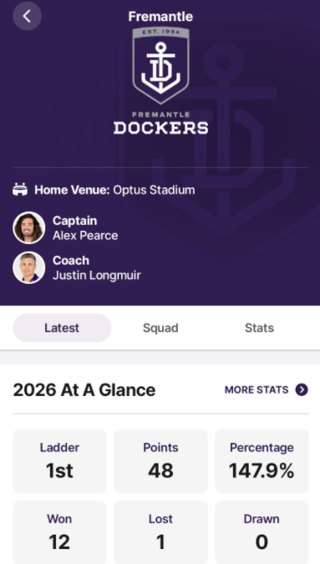
Consistency

Slide 23
Costs in the Tribunal
Zorzi and Town of Cambridge [2025] WASAT 77 (S)

Slide 24
Costs in the Tribunal
The presumption is that parties bear their own costs, but the Tribunal has a broad discretion.
The discretion includes the power to compensate for expenses, loss or inconvenience or embarrassment resulting from the proceeding or the matter because of which the proceeding was brought.

Slide 25
Costs in the Tribunal
‘(3) The power of the Tribunal to make an order for the payment by a party of the costs of another party includes the power to make an order for the payment of an amount to compensate the other party for any expenses, loss, inconvenience, or embarrassment resulting from the proceeding or the matter because of which the proceeding was brought.’

Slide 26
Costs in the Tribunal
Approach to costs:
robust and broad brush;
stringent and proportional;
objective to minimise cost to parties.

Slide 27
Costs in the Tribunal
rates and taxes;
design and drafting fees;
site management fees;
fees for compactor hire;
general labour hire;
crane hire;
excavator fees and tree surgeon fees;
labour costs;
plant hire and materials;
project management fees; and
mortgage interest payments.

Slide 28
Costs in the Tribunal
Costs cannot be used as a damages claim.
Threat of costs cannot be used to deter compliance action.

Slide 29


Slide 30
Tree Retention
Nee and Town of Bassendean [2026] WASAT 66.

Slide 31



Wharfie Time

Slide 32

Planning Law as a Limited Series
Now Streaming
10 June 2026
Isabella Mosole
Senior Associate
Lavan
Notes:
Holding Slide Option 1

Slide 33

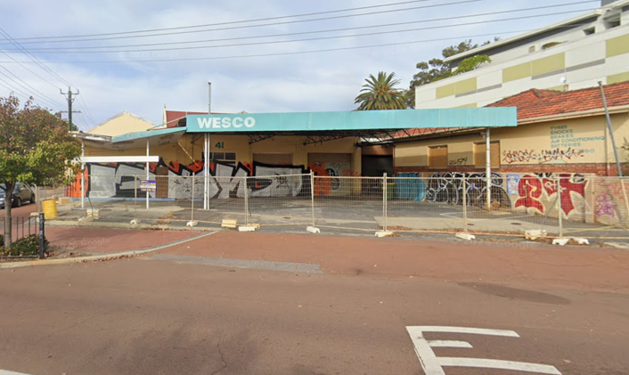
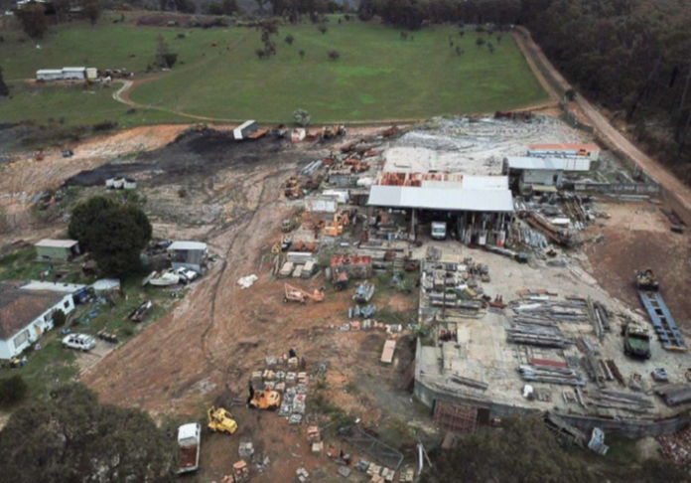

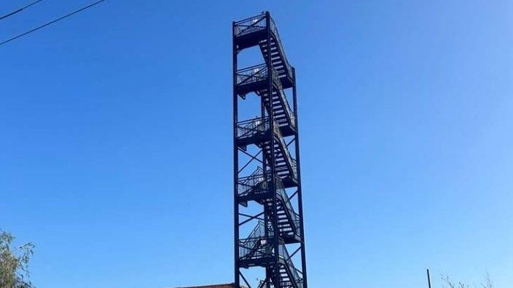
Bingeworthy Cases
CASE STUDY 01
CASE STUDY 02
CASE STUDY 03
CASE STUDY 04
The Servo That Wouldn’t Die
The Shed That Knew Too Much
Scrap Metal & The Harbour Master
The Man Who Lived 4 KM’s Away

Slide 34


OTR 208 PTY LTD v CITY OF VINCENT [2025] WASAT 117
Legal Thriller · Rating M · [Mature Planning Audiences]
Synopsis: They fenced it off, but you can’t kill what’s already approved.
Legal issue: Non-conforming use rights
Cast & Crew ›
OTR 208 Pty Ltd
City of Vincent
Applicant
Respondent

Slide 35
OTR 208 PTY LTD v CITY OF VINCENT [2025] WASAT 117
Season 1 Episode Guide
EPISODE 1
The Facts
Land used for service station since circa 1967.
2002 – DA granted for “Service Station” and “Vehicle Sales Premises”
2018 – TPS1 repealed and LPS2 Gazetted. LPS2 did not prohibit “service station” use.
2021 – Applicant purchases land.
2022 – DAP refuses application for redevelopment of land and adjoining lot.
2023 – Applicant lodges application for works approval.
2024 (Feb) – Amendment 12 to LPS2 Gazetted making “service station” a prohibited use.
2024 (August) – Works application refused
Season 2 coming late 2026
Season 1 cont.
EPISODE 2
EPISODE 3
FINALE
The Question
The Reasoning
The Ruling
Does the land have the benefit of existing use rights or non-conforming use rights for use as a ‘service station’?
If the answer is ‘yes’, is development approval required for the proposed works?
The clock cannot start until the use becomes non-conforming.
Discontinuance is a question of fact and degree – intention matters, not just physical cessation of operation.
Having a right to use land does not = a right to build.
The land has the benefit of non-conforming use rights for use as a service station.
The proposed works the subject of the works application require development approval.

Slide 36

SMARGIASSI NOMINEES PTY LTD v SHIRE OF COLLIE [2024] WASC 16
Rural Drama · Rating MA15+ · [Contains scenes of repeated prosecution]
Synopsis: Just because you got away with it under the old rules, doesn’t mean you can rewrite history.
Legal issue: Non-conforming use rights
Cast & Crew ›
Smargiassi Nominees Pty Ltd
Shire of Collie
Plaintiff
Defendant

Slide 37
SMARGIARSSI NOMINEES PTY LTD v SHIRE OF COLLIE [2024] WASC 16
Episode Guide
EPISODE 1
The Facts
2006 – Approval granted for “Light Industry (Engineering, Fabrication & Earthmoving services)” under earlier scheme.
2009 – Earlier scheme repealed and TPS5 Gazetted. “Light Industry” becomes “X” use in zone.
2014 & 2015 – Plaintiff convicted for unlawful use of land for storage.
2021 – TPS5 repealed. TPS6 Gazetted. “Light Industry” use still prohibited in zone but TPS6 introduced non-conforming use provisions.
EPISODE 2
EPISODE 3
FINALE
The Question
The Reasoning
The Ruling
Does the 2006 approval survive gazettal of TPS5?
Can a “non-conforming use” be established considering convictions?
What counts as proof of “actual lawful use” at scheme commencement?
"X" = prohibition on use.
A consent is not a general licence; it authorises only under that instrument.
Without "appropriate transitional provisions“, approval loses effect on scheme replacement.
Non-conforming rights require proof of actual lawful use at commencement date — not just a paper approval.
The 2006 approval is dead.
No non-conforming use.
Prior convictions are fatal.

Slide 38


OMSB PTY LTD v SHIRE OF ASHBURTON [2025] WASAT 24
Industrial Action · Rating PG· [Contains scenes of aggressive excavation]
Synopsis: They said it was just loading cargo. The noise said otherwise.
Legal issue: Incidental uses; Scope of development approvals
Cast & Crew ›
OMSB Pty Ltd
Shire of Ashburton
Applicant
Respondent

Slide 39
OMSB PTY LTD v SHIRE OF ASHBURTON [2025] WASAT 24
Episode Guide
The Facts
2014 – DA granted for “Harbour or Marine Facilities”.
Late 2023: Applicant commenced decommissioning activities (receiving/segmenting offshore gas infrastructure).
Shire issues a direction to cease the decommissioning use.
Applicant also lodged a retrospective application for sub-surface liner works already done. Retrospective application refused.
Two SAT applications: (1) review of direction; (2) review of DA refusal.
EPISODE 2
EPISODE 3
FINALE
The Question
The Reasoning
The Ruling
Were the decommissioning activities incidental to the approved use of the site, or a separate and distinct use?
Are sub-surface liner works “development”?
“Incidental to” is a question of fact and degree. Relevant factors include appearance, scale, revenue, traffic, offsite impacts etc.
Conditions of development approval incorporating scheme definition are locked at the date of issue. Apply a "fair but liberal reading" aimed at practical results.
“Extension of use” exemptions are narrow.
Decommissioning = distinct use.
Sub-surface liner works = development.
Retrospective development application granted.

Slide 40
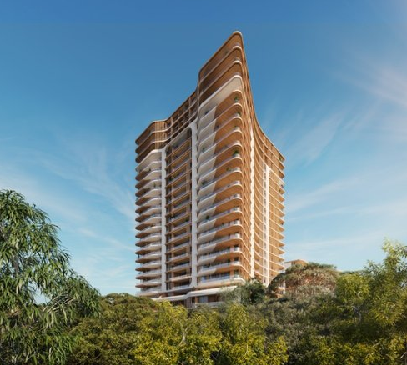

3 KILPA CRT CITY BEACH PTY LTD v TOWN OF CAMBRIDGE [2025] WASAT 102
Procedural Comedy · Rating G· [Gentle viewing]
Synopsis: He had opinions. He had passion. He did not have standing.
Legal issue: Third Party Standing.
Cast & Crew ›
3 Kilpa Crt City Beach Pty Ltd
Town of Cambridge
Mr. Ralph
Applicant
Respondent
3rd Party

Slide 41
3 KILPA CRT CITY BEACH PTY LTD v TOWN OF CAMBRIDGE [2025] WASAT 102
Episode Guide
The Facts
WAPC approved 23-storey mixed-use tower (Ocean Village, City Beach).
Applicant applied for temporary 10-storey viewing tower. Town refuses.
Applicant seeks review of decision by SAT.
Mr Raph (Floreat resident) applies to intervene in proceeding under s 37(3) of the SAT Act or to make submissions under s 242 of the PD Act. Argued Town’s inconsistency would set precedent for structure planning near his property.
EPISODE 2
EPISODE 3
FINALE
The Question
The Reasoning
The Ruling
Does Mr Ralph have “sufficient interest”?
Can concern about “precedent” give standing?
Is living in the same local government area enough to demonstrate “sufficient interest”?
Mr Ralph’s interest is intellectual/emotional – not “sufficient”.
"Sufficient interest" = more than any other member of the public (ACF test).
Must show liable to suffer disadvantage from the decision itself.
Decisions on development approvals are distinct from decisions relating to structure plans.
Application to intervene and application to make submissions both dismissed as Mr Ralph did not have a sufficient interest beyond the public at large.

Slide 43
Q&A – LEGAL UPDATE
Isabella Mosole Senior Associate Lavan
Craig Slarke
Partner
McLeods

