Slide 1
LEEDERVILLE CARPARK REDEVELOPMENT
John Corbellini – Director Major Projects – City of Vincent

Slide 2
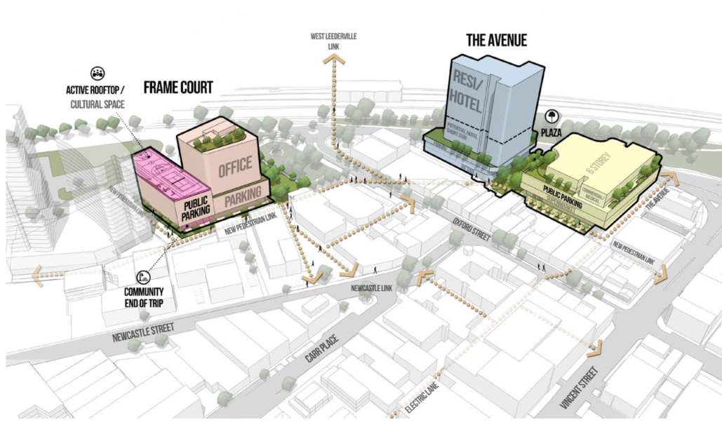
Redevelopment Vision

Slide 3
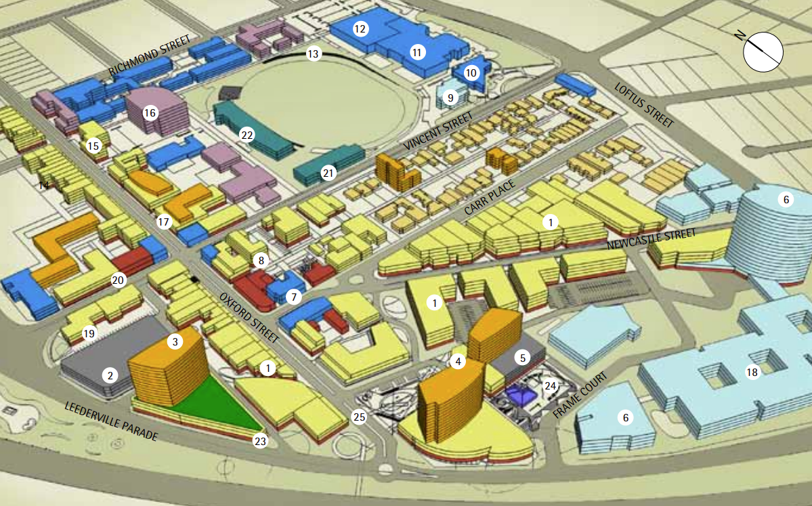
History
2007 Council first Adopted the Leederville Masterplan and Built Form Guidelines

Slide 4
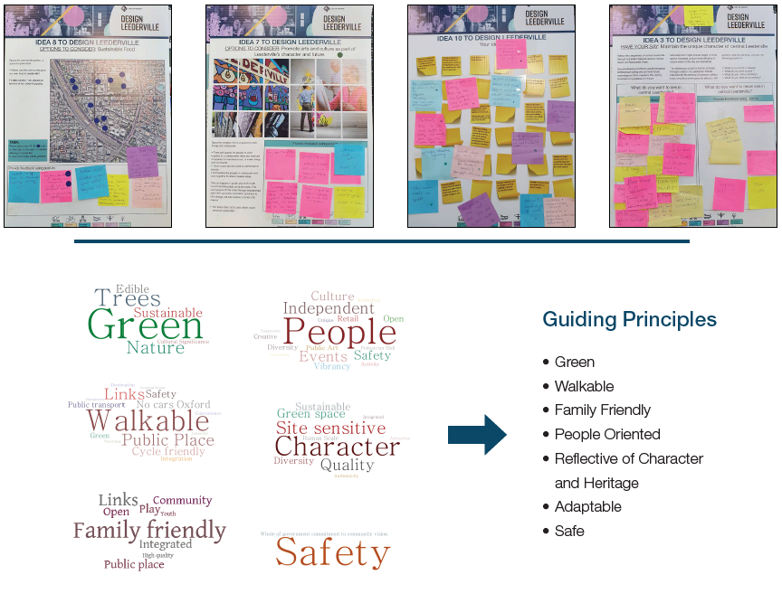
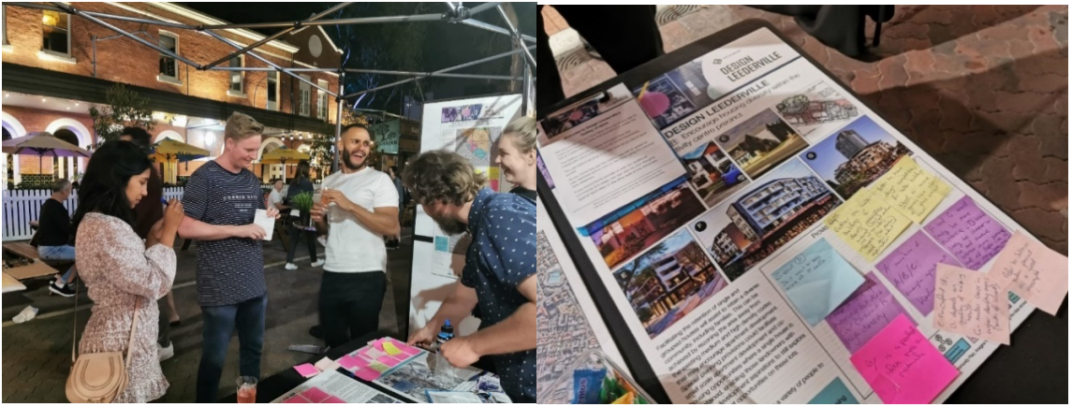
Community
2019 - 2021 Consulted with the community on the future of Leederville
Where we were?
Where we wanted to be?
Whether we got it right?

Slide 5
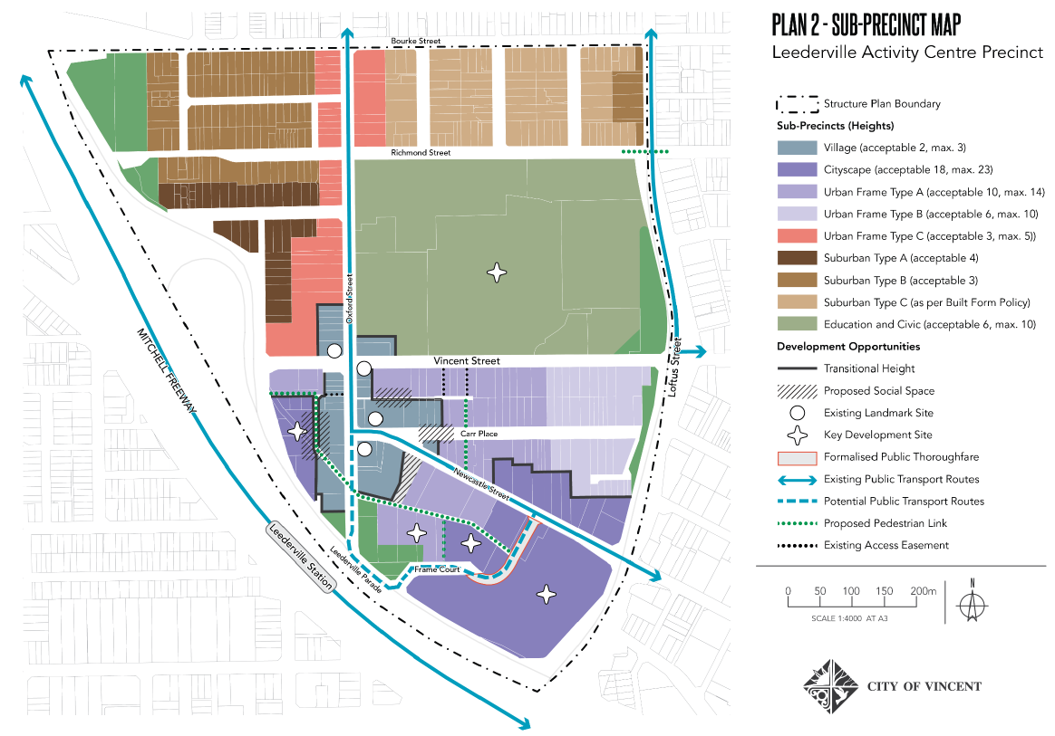
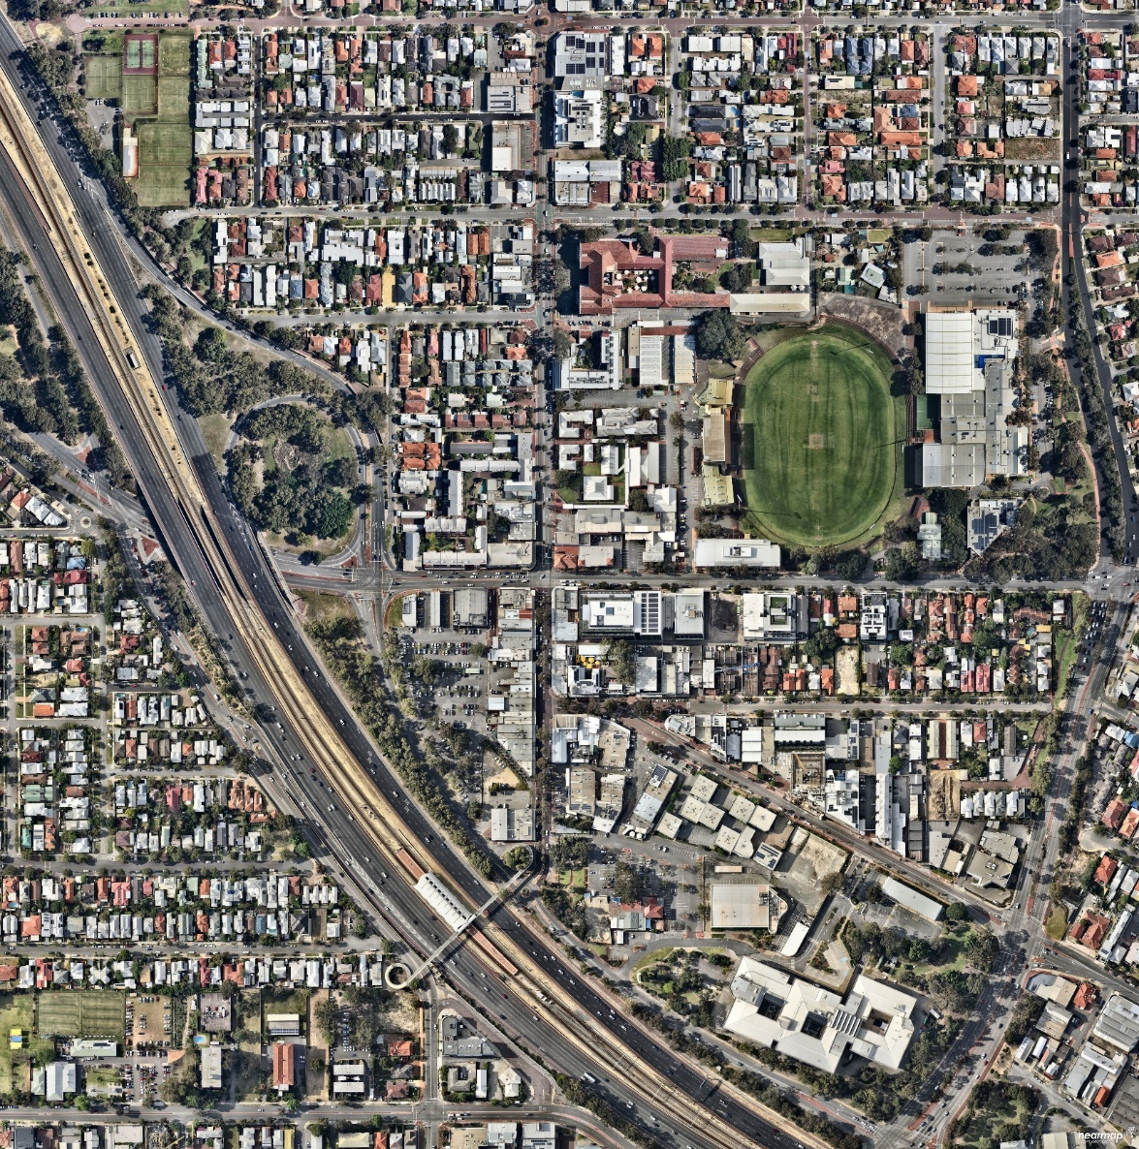
Planning First
August 2021 Council approved the Leederville Precinct Structure Plan and Leederville Town Centre Place Plan

Slide 6
Local Government Act Process
December 2021 Council approved the development of a Request For Proposal (RFP) process
June 2022 Council approved the Stage 1 materials for a RFP process
June – August 2022 RFP advertised with 8 proposals received
September 2022 Council shortlisted 3 of the proposals and requested further details from those
– February 2023 shortlisted
May – July 2023 Council selected Hesperia Property Pty Ltd’s proposal as the preferred proposal; endorsed non-binding key terms of a Heads of Agreement with Hesperia; and approved advertising the Business Plan for a Major Land Transaction with Hesperia
July – September 2023 Public Notice period carried out with over 200 submission received (approximately 95% in favour and 5% with concerns - most of which related to the
reduction in parking during construction of the multistorey car park)
November 2023 Council endorsed the Major Land Transaction
January 2024 Transaction documents executed by City of Vincent and Hesperia

Slide 7
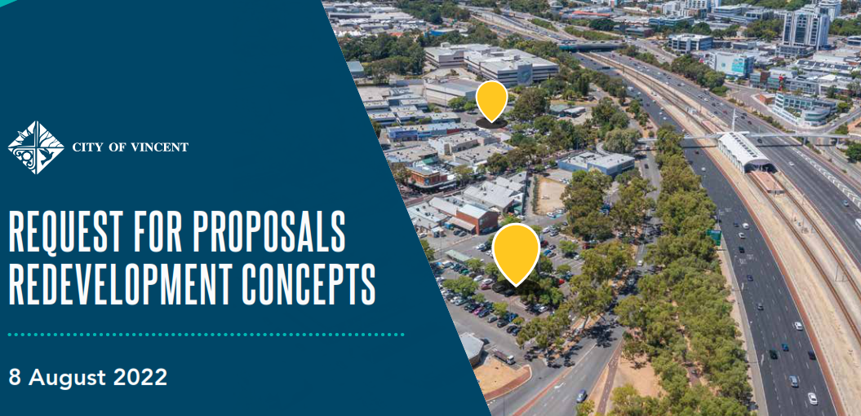
Request Requirements
ONE REQUIREMENT
400 Public Car Bays
WEIGHTED CRITERIA
50% Design Assessment
30% Process Proposed
20% Financial Capacity
and Track Record

Slide 8
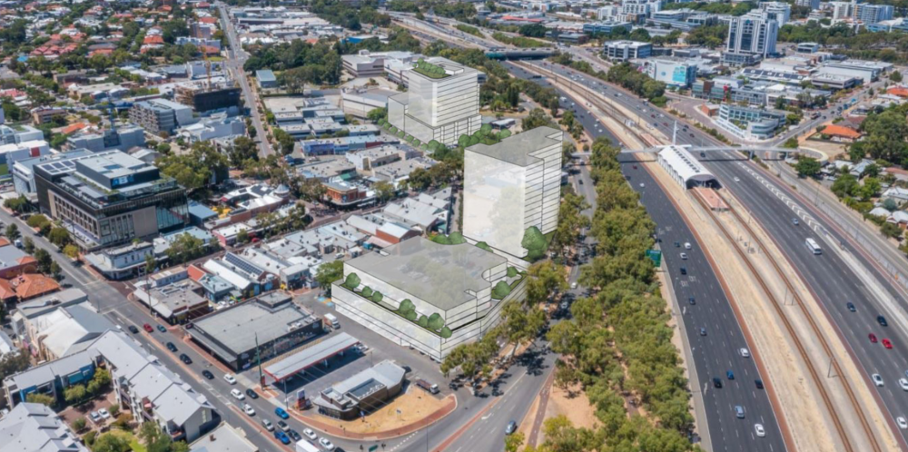
Expert Advice & Evaluation Panel
External Members
General Manager Regional DevelopmentWA
Both Co-Chairs of Vincent’s Design Review Panel
City of Vincent Members
Executive Director Strategy and Development
Executive Manager Strategic Projects and Urban Design
Senior Lands and Legal Officer
Expert Advice
Probity Advisor - Stantons
Property Advisor - Cygnet West
Legal Advice - Jackson MacDonald
Procurement
Finance

Slide 9
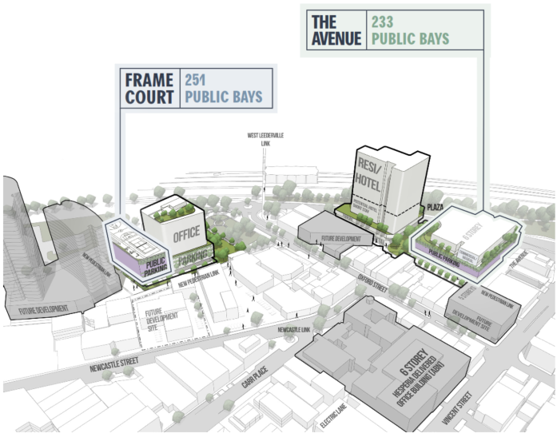
Proposed Transaction
The City of Vincent would own the 251 bay Frame Court Car Park on a greentitle lot in freehold, plus the 16 car bays proposed in roads
The City would be provided $10 million
The remaining land would be transferred to Hesperia in stages
The City of Vincent would have the first right of refusal for a lease of the 233 bay public car park on the north side of The Avenue Carpark site. If the City does not lease this car park it would be required to be run this car park as a public car park by a third party

Slide 10
Undiscounted Annual Cashflows

Slide 11
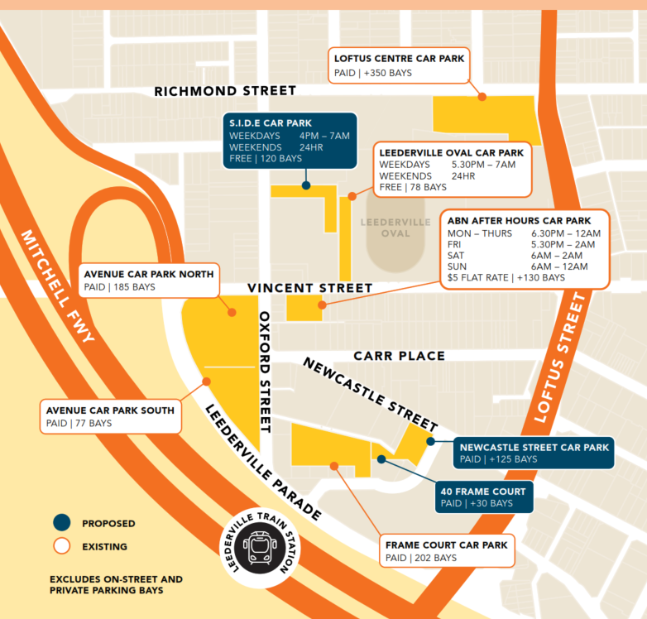
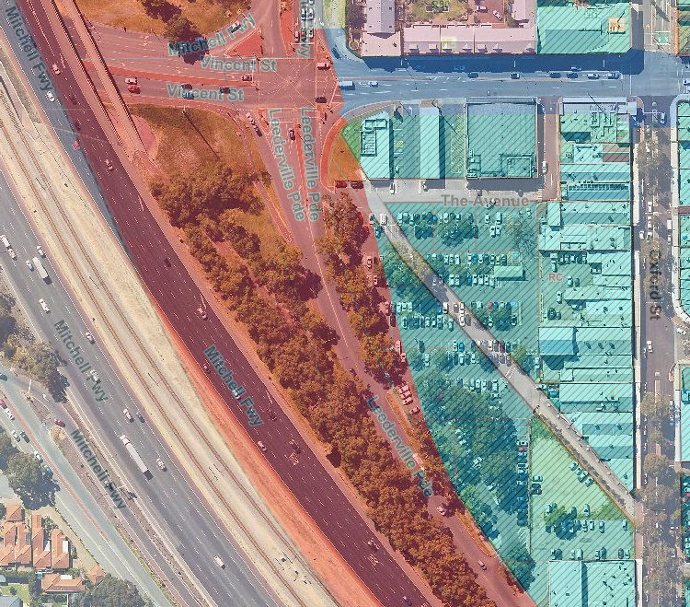
Everyone Wants to Help

Slide 12
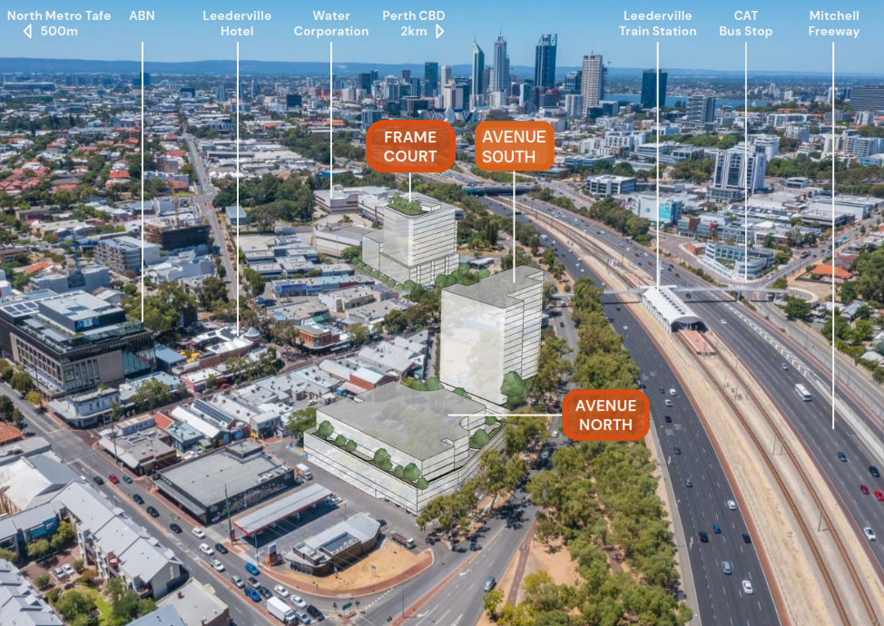
Future Opportunities

