Slide 1
LOT 1780 GASTON ROAD, BULLSBROOK stock Feed Grain Mill
Part 17 Significant Development Pathway Application – ‘SDAU’
Prepared for Local Government Planner’s Association
February 2023

Slide 2
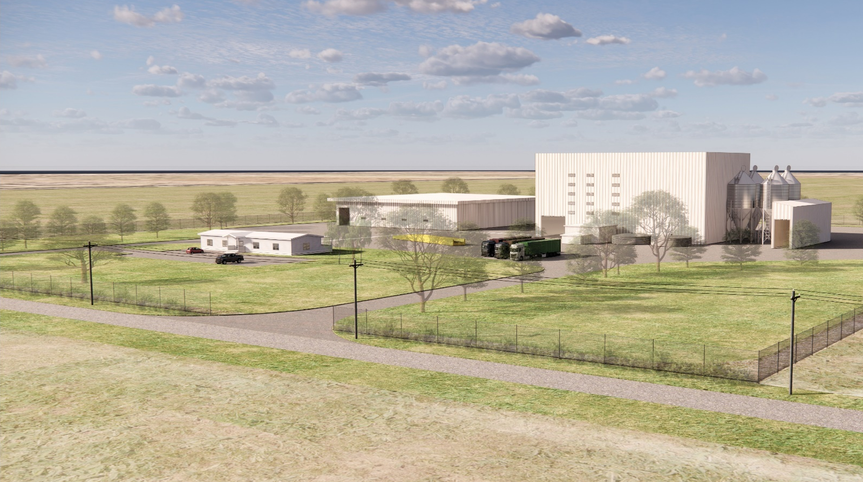
Proposed Development
Three (3) buildings – administration, stock feed grain mill building and packing/warehouse building
Four (4) grain silos and utility infrastructure
Operate 24 hours a day
Maximum 26 employees on site (total 43 employees)
Classified as ‘Industry – General’
Produces food for monogastric feed market – i.e. produces products to support agricultural activities
Smaller proposal previously refused by JDAP and subsequently the SAT

Slide 3
Why SDAU?
Land Use Due Regard
Supreme Court decision not ‘Industry – Rural’
‘Industry – General’ is ‘X’ under City of Swan LPS17
Consistency with zone objectives and strategic planning
Lack of appropriate alternative locations
Value of Development
$25 million
Inclusive of the equipment and road construction costs – Integral to the use
Various elements interrelated and dependent on each other
Financed and ready to go
Does not rely on pre-sales or external financing
Construction and other site preparation tasks ready to commence (18 months)

Slide 4
State Significance
Economic Competitiveness and Capacity
Food security
Local Employment

Slide 5
Economic Benefit
Jobs
Benefit
Employment and competitiveness
19 new ongoing jobs
67 new indirect ongoing jobs
36 construction jobs
Support growth of other businesses
Withdraw eastern states contracts
$24.7 million of investment in construction
$17.4 million net value added to WA economy
New roads built at minimal cost to government
Growth of agricultural industry (intensive livestock)
Supports equine industry and recreational horse owners
Food security and improved supply chain reliability
Increased local employment and self sufficiency
Lower freight costs – significant savings to local industries
Competitive advantage for export contracts

Slide 6
Orderly and proper planning
Model Scheme Text – 2015
Proximity of industrial
Purpose of Scheme and Zone
Generally more broad than 1999 definition used within City of Swan LPS17
Proposed activity would comply with MST 2015 ‘Industry – Rural’ definition
Purpose and intent of ‘Industry – Rural’ land use to support activities such as that proposed.
Within Bullsbrook Freight and Industrial Land Use Strategy Precinct ‘F’ – in 70+ years to be industrial/freight development
Local Planning Strategy – Bullsbrook as future industrial land supply
Local Rural Strategy – North Bullsbrook ideal for rural industries and identifies semi-industrial activities
5km to south – Bullsbrook South Industrial precinct
Support economic base
DPIRD advised site has low land capability for agricultural purposes
Will not fragment land or prevent another use in the future – alignment with future use
Scale and intensity of development appropriate
Visual amenity not compromised

Slide 7
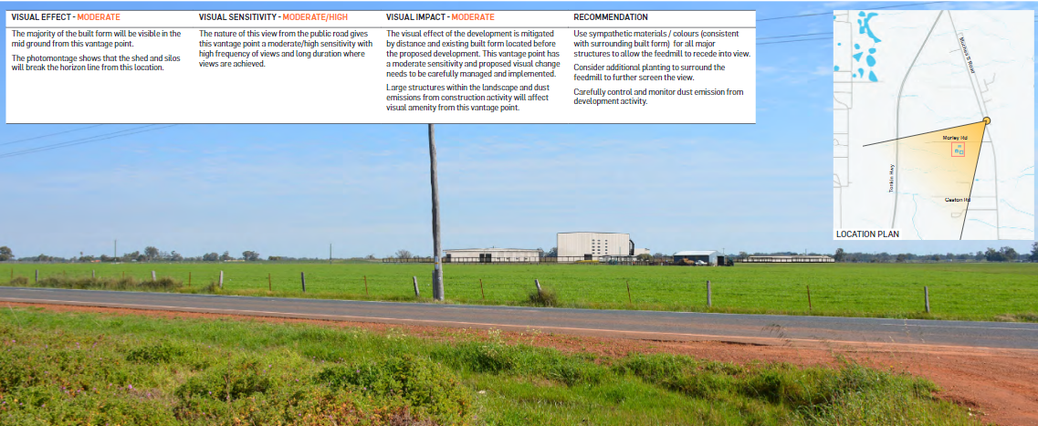
Visual Impact

Slide 8
How concerns addressed
Management
Development approved as ‘Stock Feed Grain Mill’ rather than ‘Industry – General’ – avoids change in specific activity
Road upgrades – MRWA benefit
Parking, access and delivery management plan
Environment
Wastewater plan – manage impact on environment
Waste management plan
Stormwater management plan
Pest management plan
Environmental management plan (noise, dust and odour)
Amenity
Landscaping plan – as per visual impact assessment
Noise management plan

